Slide 1
THE PRINCE’S TRUST
EMPOWERING YOUNG PEOPLE TO SECURE BETTER FUTURES

Slide 2
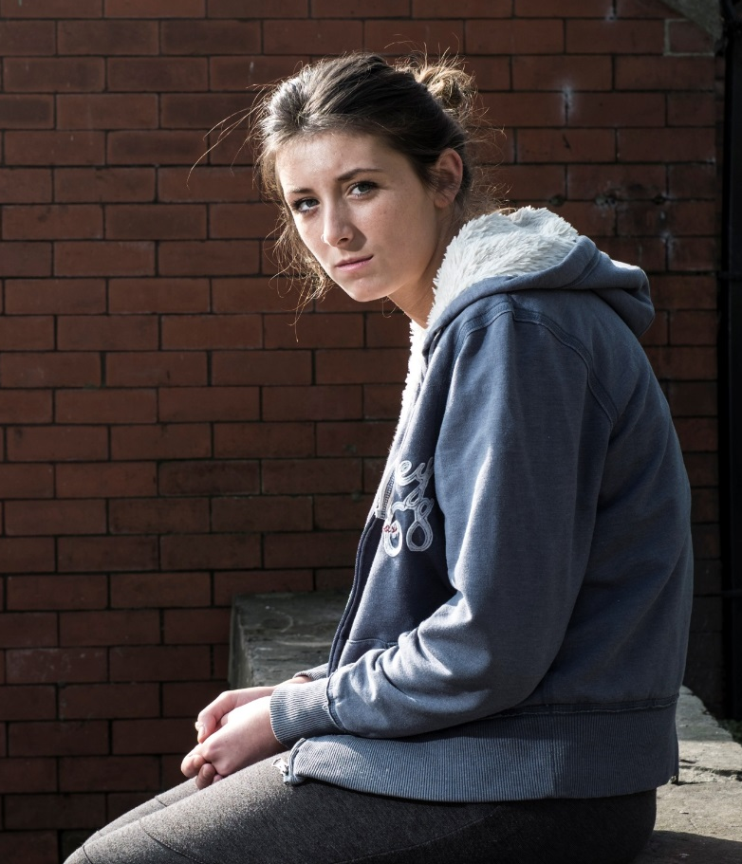

What we do
As the UK’s leading youth charity, The Prince’s Trust offers practical and emotional support
to young people aged 11-30 who are:
struggling at school
living within or leaving the care system
long term unemployed
battling with mental health issues
or have been in trouble with the law
Through 8 tailored programmes, we help young people build confidence and develop skills so they can move into education, a job or self-employment.

Slide 3
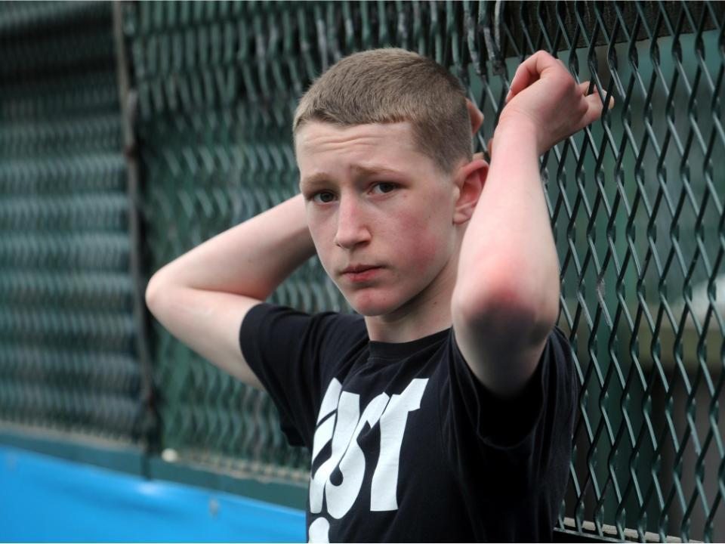
THE SCALE OF THE PROBLEM
*
560,000
*
Over 50%
Young people are unemployed, three times the UK adult rate.
Of children’s prospects can be predicted from the social background of their parents
*
Almost 50%
*
Of unemployed young people have experienced a mental health problem
A third
Of young people leave school with fewer than 5 GCSEs.

Slide 4
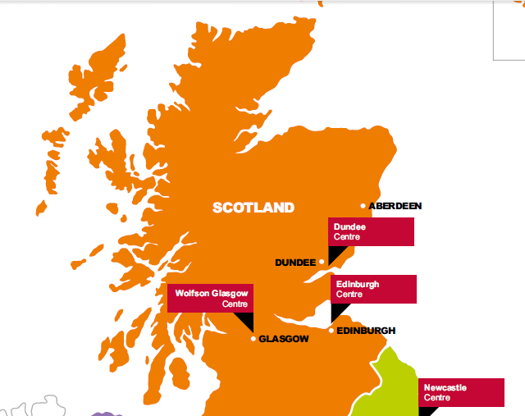
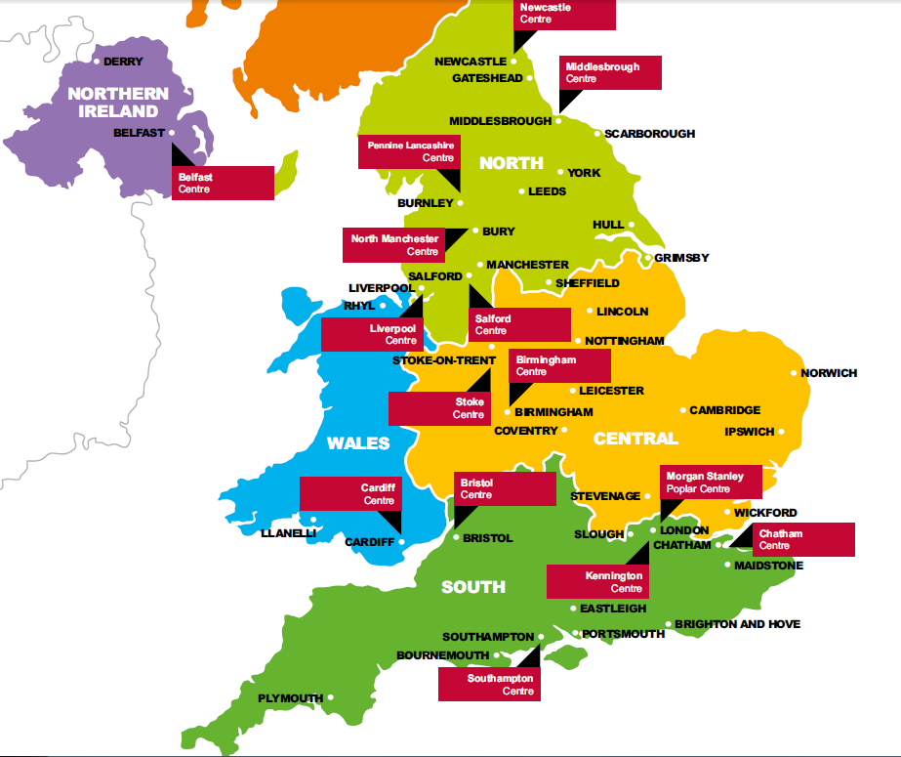
Delivery across the country
We supported 57,667 young people in 16/17
£70m annual income raised
85p in every £1
Scotland
9,496 young people supported
Northern Ireland
7,136 young people supported
North
13,081 young people supported
Wales
3,351 young people supported
Central
13,412 young people supported
South
11,191 young people supported

Slide 5
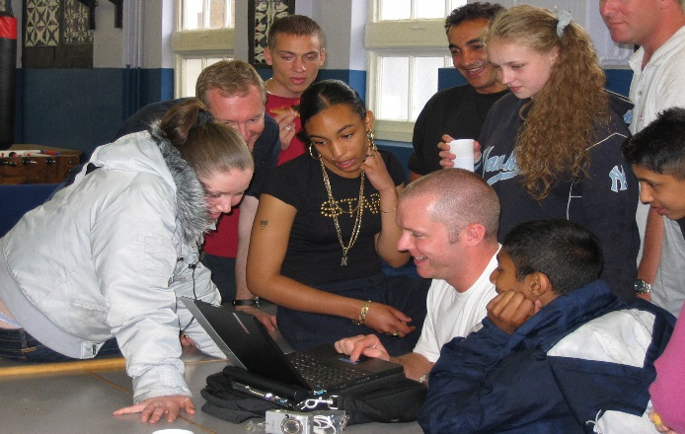
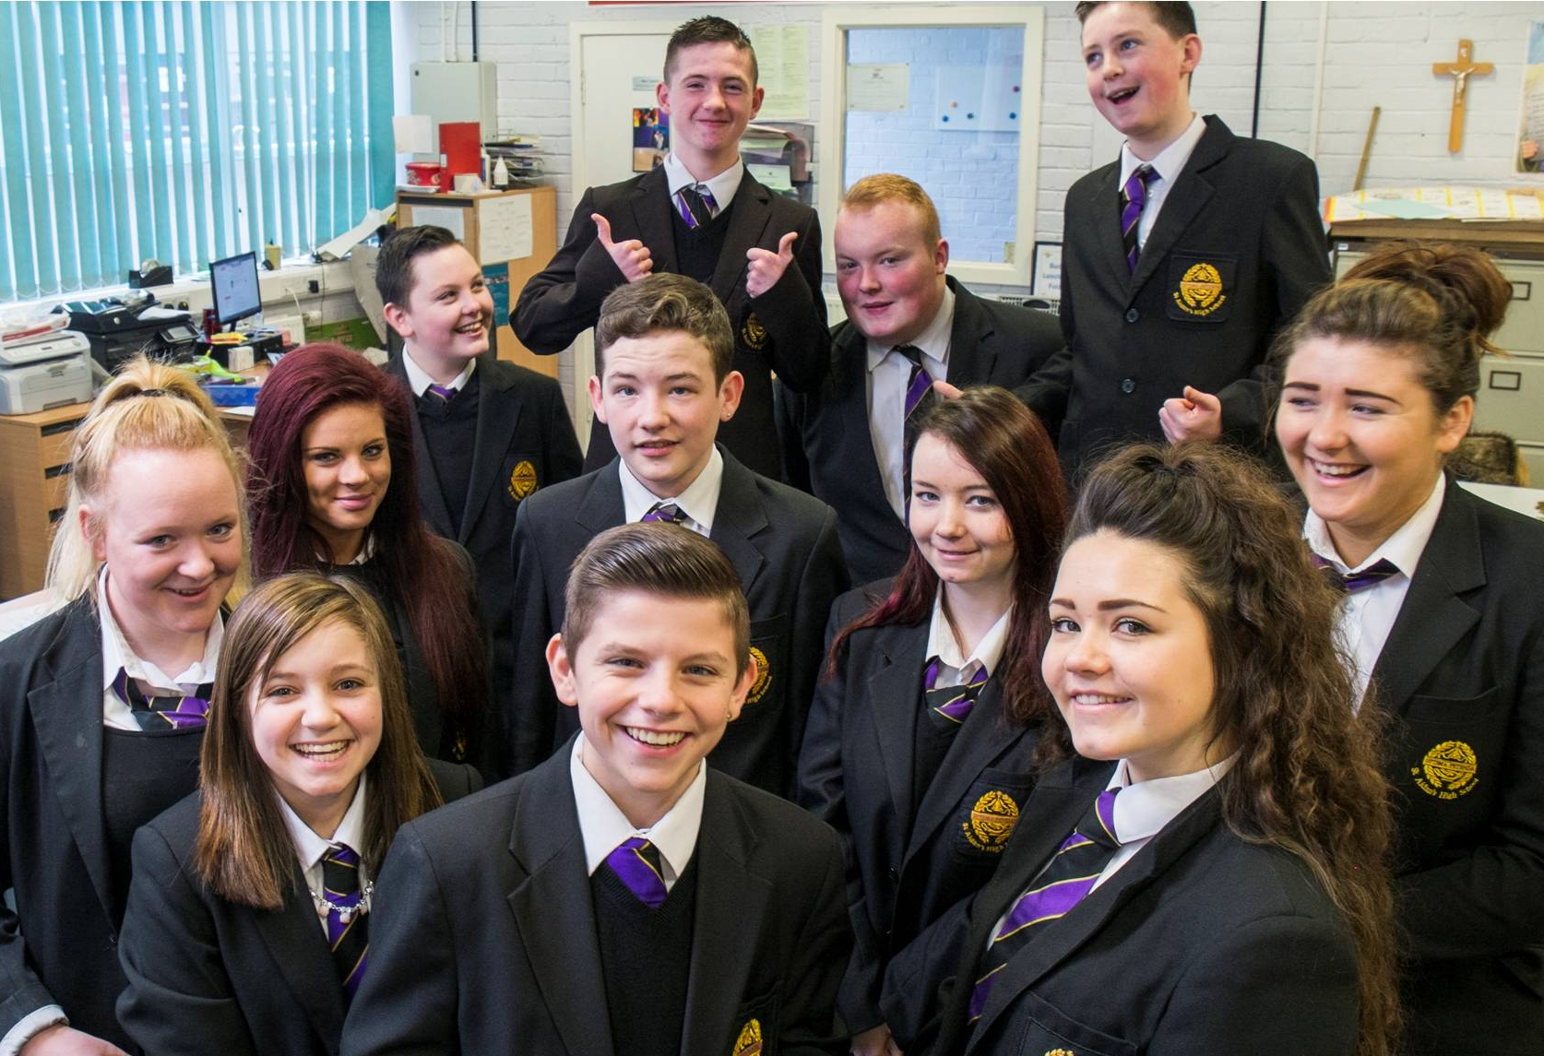
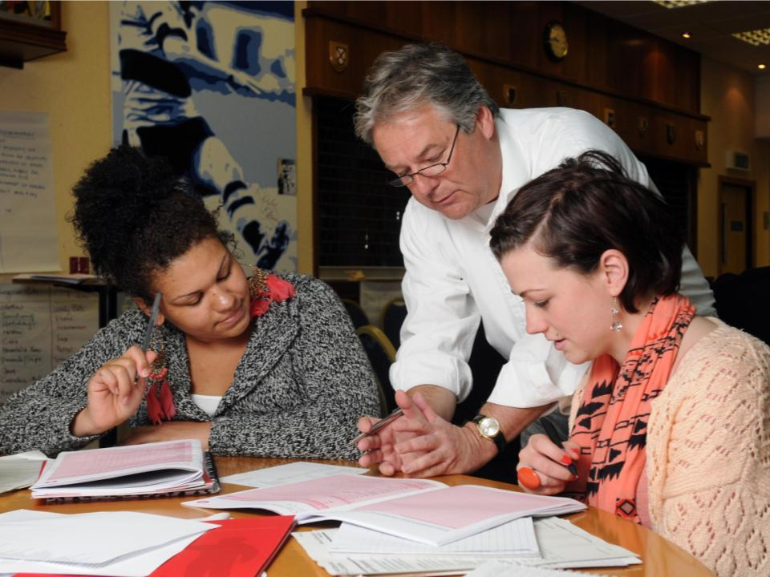
How Corporates Help
CV Interview Workshops
Expert Panellists
Business Mentoring
Inspirational Speaking
World of Work Tours

Slide 6
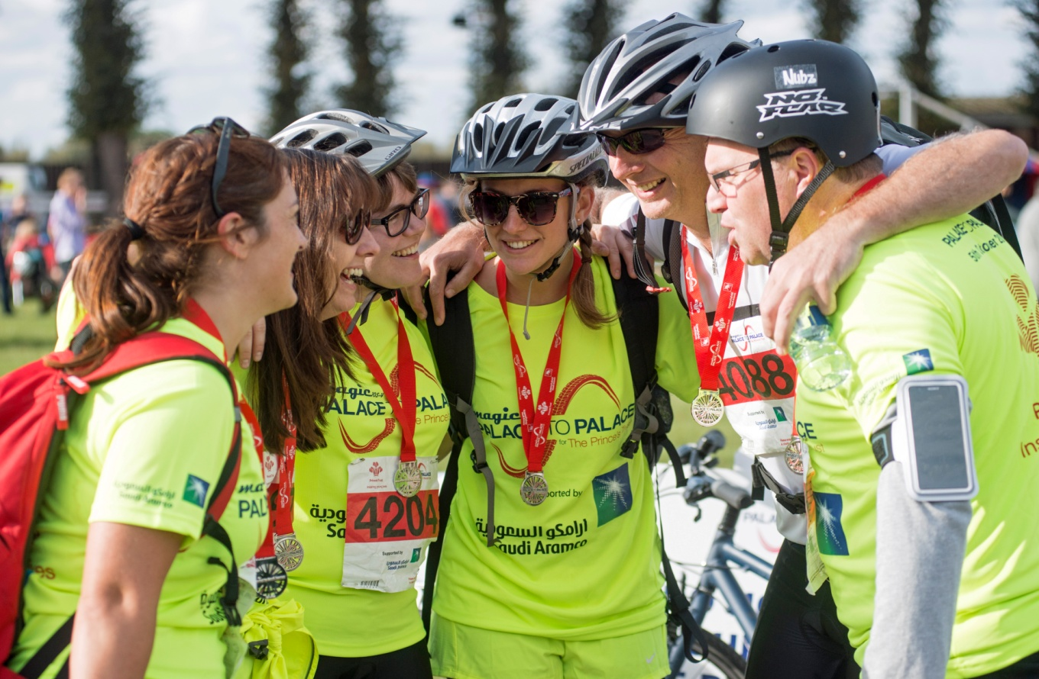
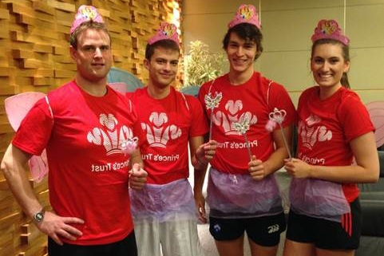
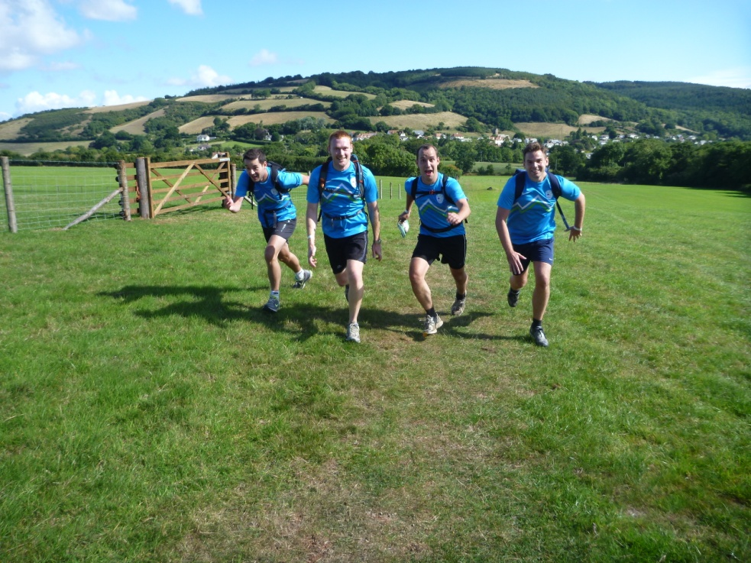
Fundraising/Active Events
Our own: The Race, Palace to Palace or Future Steps
Adventurous: Sky Dives, Polar Expeditions or Bungee Jumps
Popular: London Marathon, John O’Groats to Lands’ End bike ride or Three Peaks Challenge

Slide 7
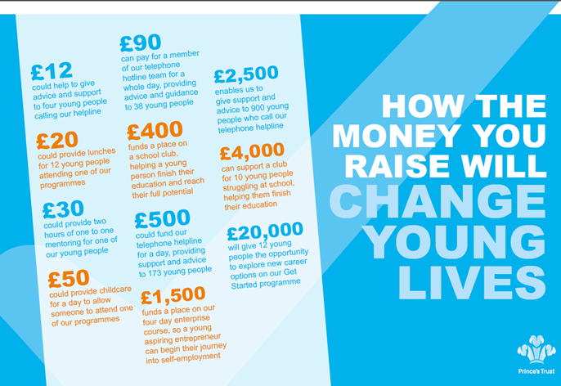
Every £ raised will make a huge difference

Slide 8



How you can help!
Become a mentor or volunteer
Sign up to Palace to Palace
Find out if your company is a corporate partner and get involved

Slide 9
